Slide 1
Corona Virus Analysis using SQL
By Gaurav Kashyap

Slide 2
Overview
Performing coronavirus analysis using SQL involves querying a dataset to extract insights such as total confirmed cases, deaths, recoveries, and trends over time. This includes handling missing values, calculating monthly and yearly statistics, identifying patterns, and determining the most and least affected regions.

Slide 3
TABLE OF CONTENTS
01
02
03
Introduction
Problem Statement
Why its needed to do Analysis?
What analysis we will do?
Dataset Explanation
04
Dataset Overview
What data we will analysis?
Given dataset for analysis
05
06
Data Exploration Using SQL
Insights Revealed
We use queries as per the problem statement for data.
We see how we can use this analysis for mankind.

Slide 4
Warm Welcome
My name is Gaurav Kashyap.
In this PPT we get to know how we can extract useful information from given dataset and how it will helpful for mankind.

Slide 5
INTRODUCTION
COVID-19, caused by the novel coronavirus SARS-CoV-2, is a highly contagious respiratory illness that emerged in late 2019. It rapidly spread worldwide, leading to a global pandemic. Symptoms range from mild (fever, cough) to severe (pneumonia, respiratory failure). Public health measures like social distancing, masks, and vaccination are critical in controlling its spread. The pandemic has had profound impacts on health, economies, and daily life globally.

Slide 6
Problem Statement
The CORONA VIRUS pandemic has had a significant impact on public health and has created an urgent need for data-driven insights to understand the spread of the virus. As a data analyst, you have been tasked with analyzing a CORONA VIRUS dataset to derive meaningful insights and present your findings.

Slide 7

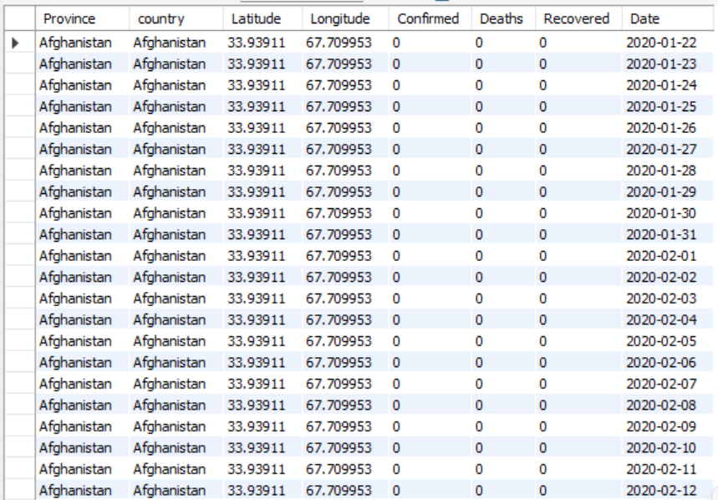
Dataset Overview

Slide 8
Dataset Explanation
Province: Geographic subdivision within a country/region.
Country/Region: Geographic entity where data is recorded.
Latitude: North-south position on Earth's surface.
Longitude: East-west position on Earth's surface.
Date: Recorded date of CORONA VIRUS data.
Confirmed: Number of diagnosed CORONA VIRUS cases.
Deaths: Number of CORONA VIRUS related deaths.
Recovered: Number of recovered CORONA VIRUS cases.

Slide 9
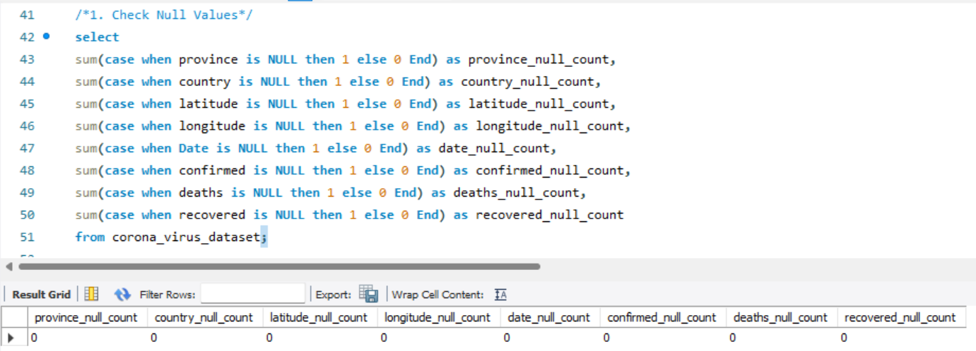
Data Exploration Using SQL
Q1. Write a code to check NULL values

Slide 10
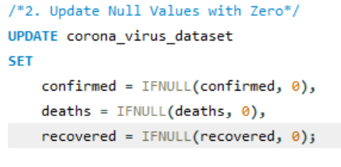
Q2. If NULL values are present, update them with zeros for all columns.

Slide 11
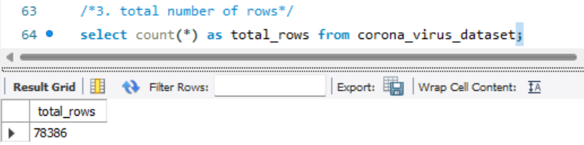
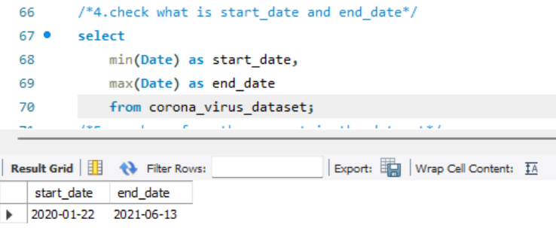
Q3. check total number of rows
Total Rows:-
78386
Q4. Check what is start_date and end_date
Start Date:-2020-01-22
End Date:- 2021-06-13

Slide 12
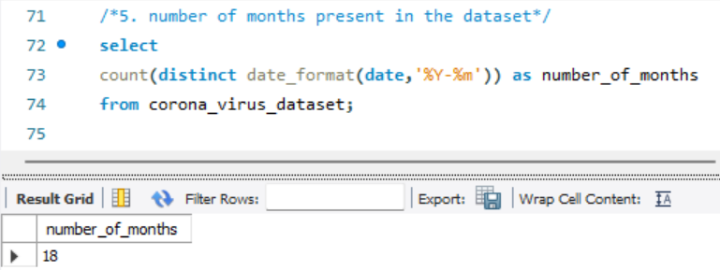
Q5. Number of month present in dataset
Total Months:- 18

Slide 13
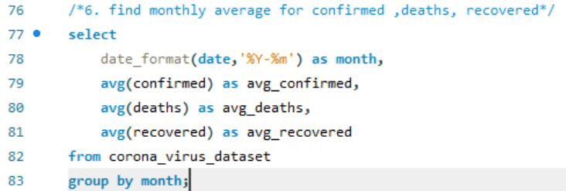
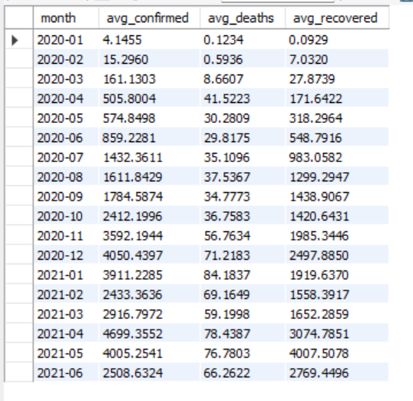
Q6. Find monthly average for confirmed, deaths, recovered

Slide 14
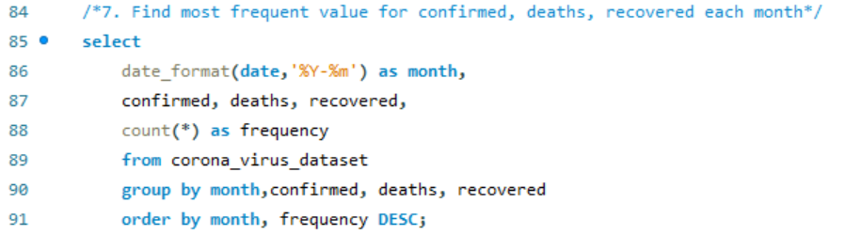
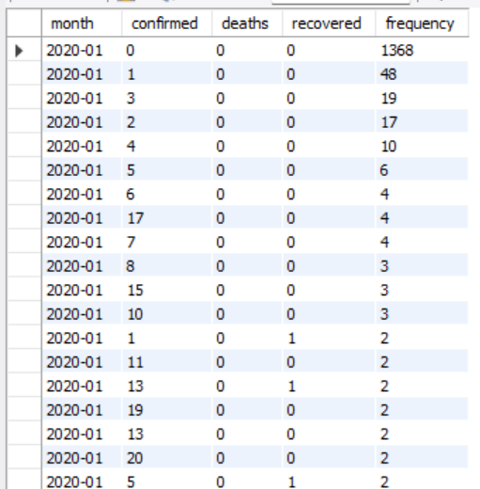
Q7. Find most frequent value for confirmed, deaths, recovered each month

Slide 15
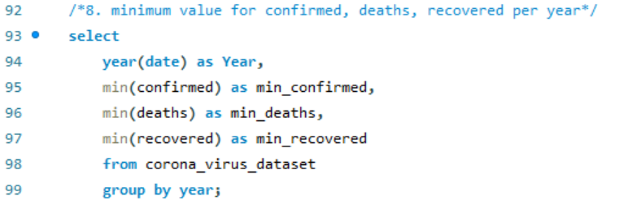
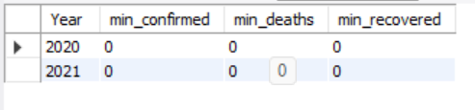
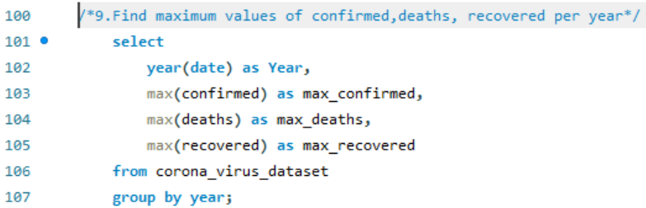
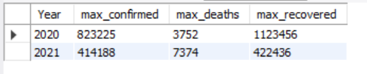
Q8. Find minimum values for confirmed, deaths, recovered per year
Q9. Find maximum values of confirmed, deaths, recovered per year

Slide 16
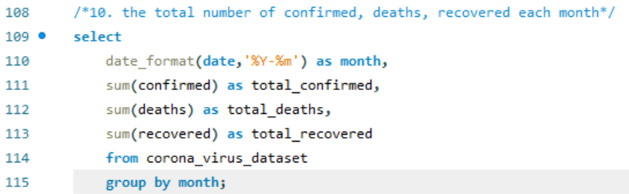
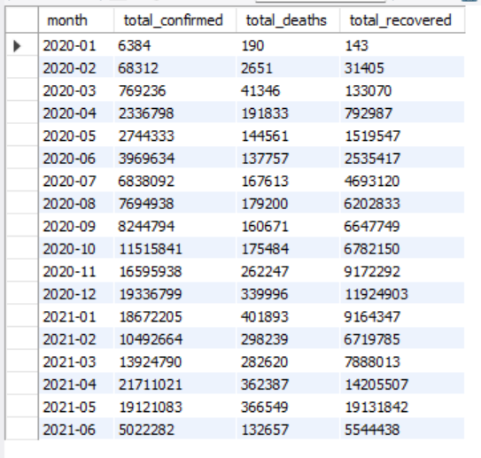
Q10. The total number of case of confirmed, deaths, recovered each month

Slide 17
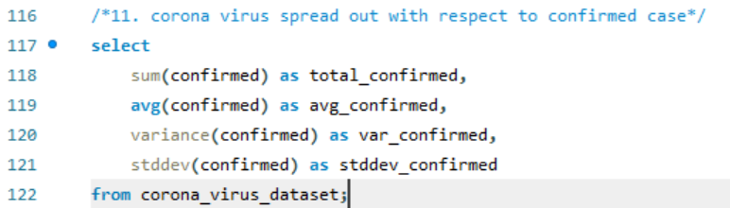

Q11. Check how corona virus spread out with respect to confirmed case
-- (Eg.: total confirmed cases, their average, variance & STDEV )

Slide 18
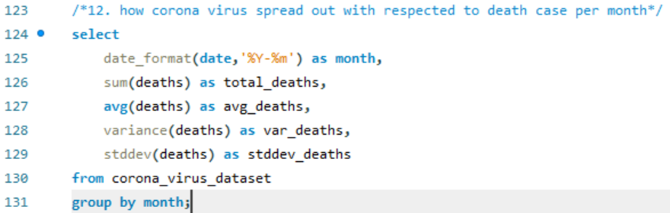
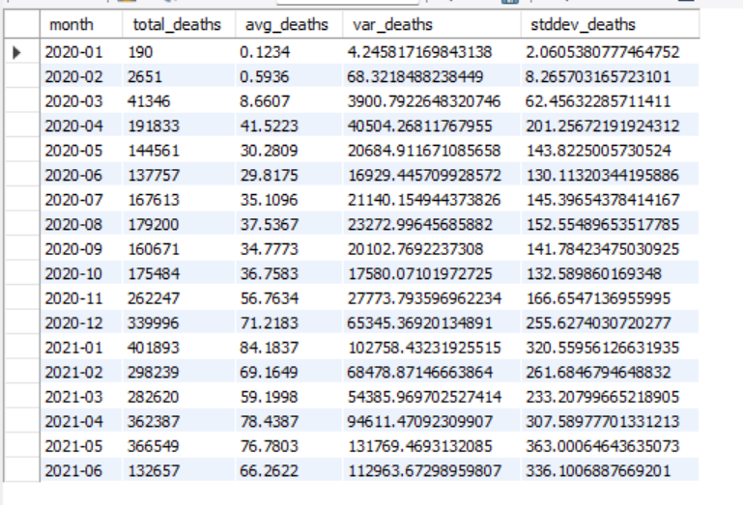
Q12. Check how corona virus spread out with respect to death case per month
-- (Eg.: total confirmed cases, their average, variance & STDEV )

Slide 19
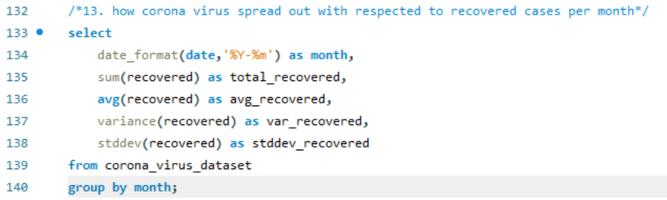
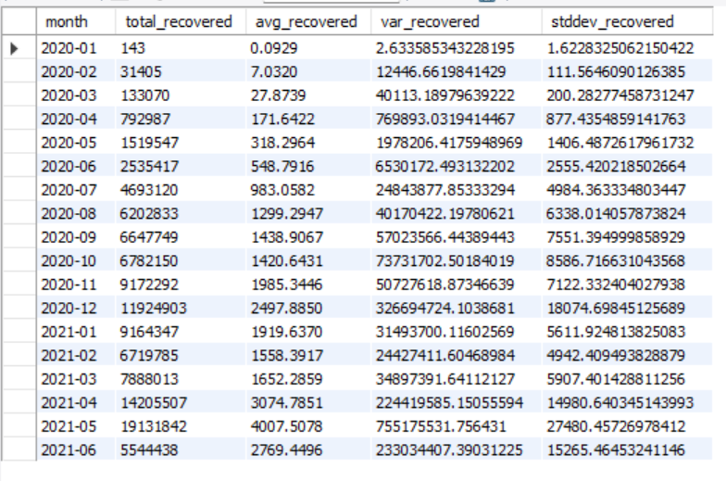
Q13. Check how corona virus spread out with respect to recovered case
-- (Eg.: total confirmed cases, their average, variance & STDEV )

Slide 20
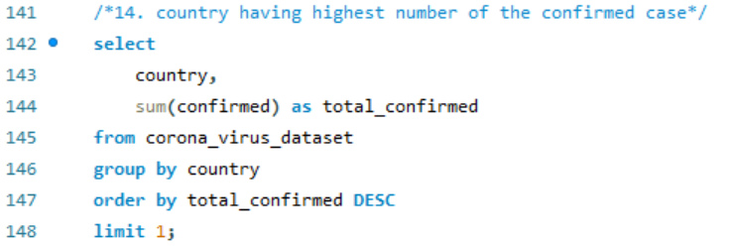
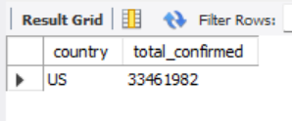
Q14. Find Country having highest number of the Confirmed case
Highest Confirmed case:- US

Slide 21
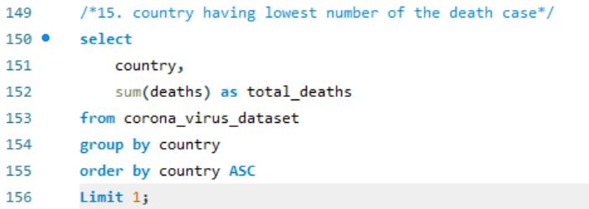
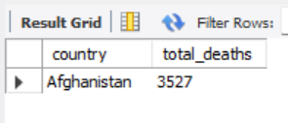
Q15. Find Country having lowest number of the death case
Lowest Death case:-Afghanistan

Slide 22
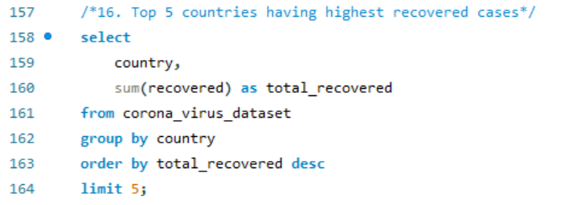
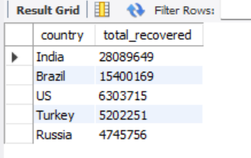
Q16. Find top 5 countries having highest recovered case

Slide 23
Key Insights Revealed
Informed Decision-Making: Provides data-driven insights for policymakers to make informed decisions regarding public health measures, resource allocation, and lockdown implementations.
Tracking and Monitoring: Helps track and monitor the spread of the virus, identifying hotspots and regions with rising cases, allowing for timely interventions.
Resource Management: Aids healthcare systems in managing resources like hospital beds, ventilators, and medical staff by predicting future case trends.
Public Awareness: Offers valuable information to the public about the current state of the pandemic, promoting awareness and adherence to safety measures.
Research and Development: Supports researchers in analyzing trends and patterns, contributing to the development of treatments and vaccines.

Slide 24

Thank you

